Slide 1
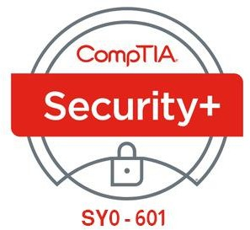
08- Implementing Identity and Account Management Controls
Ehab Fahmi
Senior Cyber Security Consultant - Instructor

Slide 2
Outlines
8.1- Implement Identity and Account Types
8.2- Implement Account Policies

Slide 3
IDENTITY MANAGEMENT CONTROLS
Identity and access management (IAM) involves both IT/security procedures and technologies and Human Resources (HR) policies.
A background check determines that a person is who they say they are and are not concealing criminal activity, bankruptcy, or connections that would make them unsuitable or risky.
For some jobs, especially federal jobs requiring a security clearance, background checks are mandatory.
Some background checks are performed internally, whereas others are done by an external third party.

Slide 4
IDENTITY MANAGEMENT CONTROLS (cont.)
Onboarding at the HR level is the process of welcoming a new employee to the organization.
As part of onboarding, the IT and HR function will combine to create an account for the user to access the computer system, assign the appropriate privileges, and ensure the account credentials are known only to the valid user.
These functions must be integrated, to avoid creating accidental configuration vulnerabilities, such as IT creating an account for an employee who is never actually hired.

Slide 5

IDENTITY MANAGEMENT CONTROLS (cont.)
The terms of an NonDisclosure Agreement (NDA) might be incorporated within the employee contract or could be a separate document.
When an employee or contractor signs an NDA, they are asserting that they will not share confidential information with a third party.

Slide 6
PERSONNEL POLICIES FOR PRIVILEGE MANAGEMENTs
HR and IT must collaborate to ensure effective privilege management.
These policies aim to ensure that the risk of insider threat is minimized.
Separation of Duties
Separation of duties is a means of establishing checks and balances against the possibility that critical systems or procedures can be compromised by insider threats.
Duties and responsibilities should be divided among individuals to prevent ethical conflicts or
abuse of powers.

Slide 7
PERSONNEL POLICIES FOR PRIVILEGE MANAGEMENT
(cont.)
Least Privilege
Least privilege means that a user is granted sufficient rights to perform his or her job and no
more.
This mitigates risk if the account should be compromised and fall under the control of a threat actor.
Least privilege should be ensured by closely analyzing business workflows to assess what privileges are required and by performing regular account audits.

Slide 8
PERSONNEL POLICIES FOR PRIVILEGE MANAGEMENT
(cont.)
Job Rotation
Job rotation (or rotation of duties) means that no one person is permitted to remain in the
same job for an extended period.
For example, managers may be moved to different departments periodically, or employees may perform more than one job role, switching between them throughout the year.
Rotating individuals into and out of roles, such as the firewall administrator or access control specialist, helps an organization ensure that it is not tied too firmly to any one individual because vital institutional knowledge is spread among trusted employees.
Job rotation also helps prevent abuse of power, reduces boredom, and enhances individuals' professional skills.

Slide 9
PERSONNEL POLICIES FOR PRIVILEGE MANAGEMENT
(cont.)
Mandatory Vacation
Mandatory vacation means that employees are forced to take their vacation time, during
which someone else fulfills their duties.
The typical mandatory vacation policy requires that employees take at least one vacation a year in a full-week increment so that they are away from work for at least five days in a row.
During that time, the corporate audit and security employees have time to investigate and discover any discrepancies in employee activity.

Slide 10
OFFBOARDING POLICIES
Offboarding is the process of ensuring that an employee leaves a company gracefully, It is also used when a project using contractors or third parties ends.
In terms of security, there are several processes that must be completed:
Account management—disable the user account and privileges, Ensure that any information assets created or managed by the employee but owned by the company are accessible (in terms of encryption keys or password-protected files).
Company assets—retrieve mobile devices, keys, smart cards, USB media, and so on, The employee will need to confirm (and in some cases prove) that they have not retained copies of any information assets.
Personal assets—wipe employee-owned devices of corporate data and applications, The employee may also be allowed to retain some information assets (such as personal emails or contact information), depending on the policies in force.

Slide 11
SECURITY ACCOUNT TYPES AND CREDENTIAL MANAGEMENT
Operating systems, network appliances, and network directory products use some standard account types as the basis of a privilege management system.
These include standard user, administrative user, security group accounts, and service accounts.
Guest Accounts
A guest account is a special type of shared account with no password.
It allows anonymous and unauthenticated access to a resource.
The Windows OS creates guest user and group accounts when installed, but the guest user account is disabled by default.
Guest accounts are also created when installing web services, as most web servers allow unauthenticated access.

Slide 12
SECURITY GROUP-BASED PRIVILEGES
The concept of a Security Group Account simplifies and centralizes the administrative process of assigning rights.
Rather than assigning rights directly, the system owner assigns them to security
group accounts.
User accounts gain rights by being made a member of a security group.
A user can be a member of multiple groups and can therefore receive rights and permissions from several sources.

Slide 13
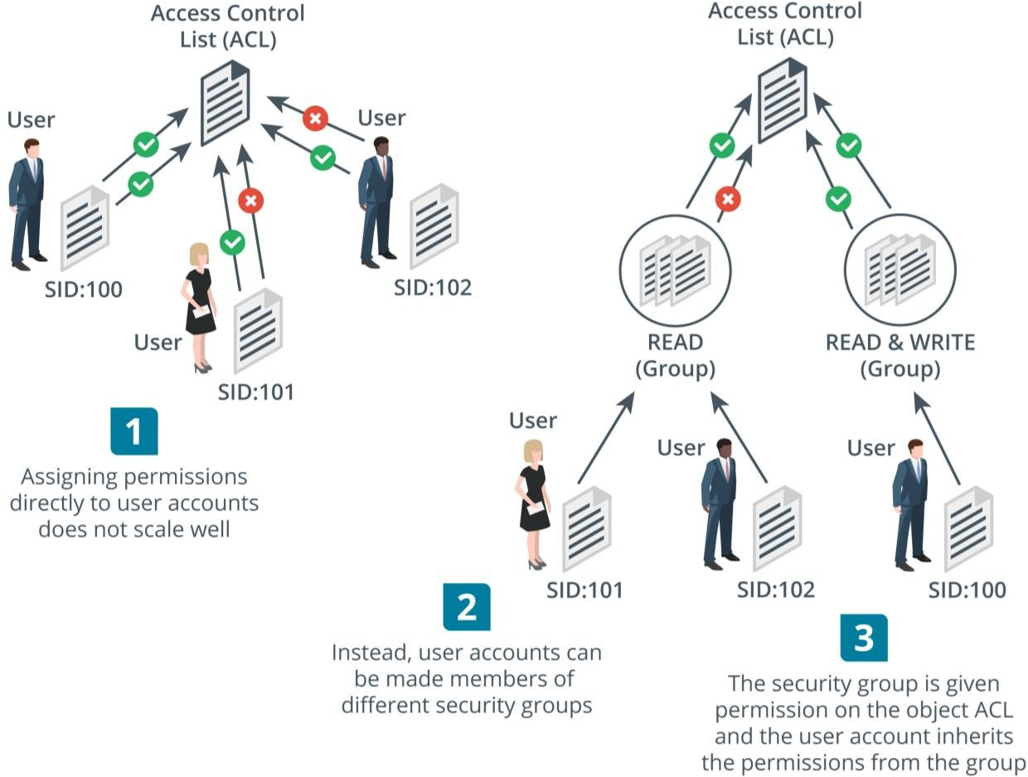
SECURITY GROUP-BASED PRIVILEGES (cont.)

Slide 14
ADMINISTRATOR / ROOT ACCOUNTS
Administrative or privileged accounts are able to install and remove apps and device drivers, change system-level settings, and access any object in the file system.
In practice, it is very hard to eliminate the presence of default administrator accounts.
A default account is one that is created by the operating system or application when it is installed.
The default account has every permission available.
In Windows, this account is called Administrator; in Linux, it is called root.
This type of account is also referred to as a superuser.

Slide 15
SERVICE ACCOUNTS
Service Accounts are used by scheduled processes and application server software, such as databases.
Windows has several default service account types.
These do not accept user interactive logons but can be used to run processes and background services:
System—has the most privileges of any Windows account, The local system account creates the host processes that start Windows before the user logs on, Any process created using the system account will have full privileges over the local computer.
Local Service—has the same privileges as the standard user account, It can only access network resources as an anonymous user.
Network Service—has the same privileges as the standard user account but can present the computer's account credentials when accessing network resources.

Slide 16
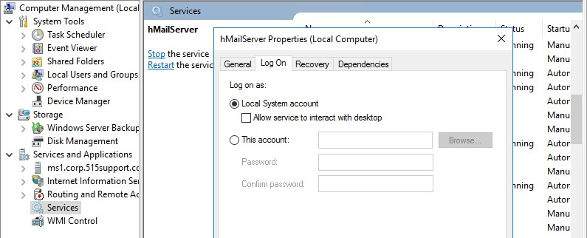
SERVICE ACCOUNTS (cont.)

